Slide 1
Schrödinger
Equation
PC2232 Lecture 8
Introduction &
Infinite Square Well

Slide 2
Outline
Meaning of Ψ(x, t)
Schrödinger equation
One Dimensional Infinite Potential Well
Example of One Dimensional Infinite Potential Well

Slide 3
QM Description of Micro-world
The likelihood of finding a particle is described by a function known as wave function.
It is denoted by the symbol Ψ(x,t).
Ψ(x,t) is a complex function of position x and time t.
Wave Function: Ψ(x,t) describes all the properties of a particle
The quantity |Ψ|² is interpreted as the probability density that a particle can be found in a particular region in space and at a particular time

Slide 4
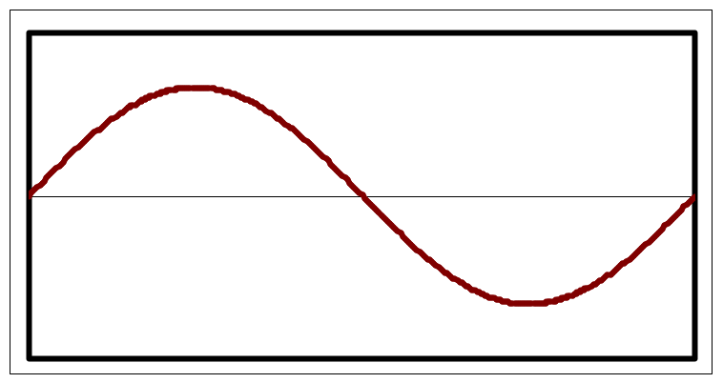
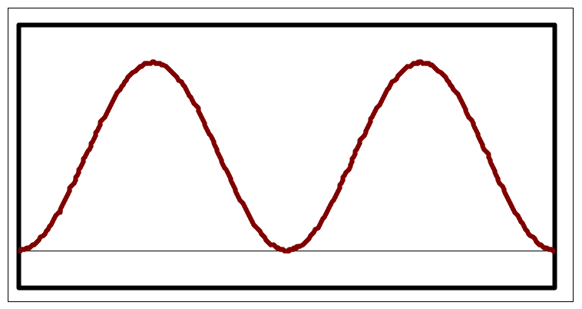
Wave Function (examples)
Ψ(x,t) may look like this
Then |Ψ|² looks like this
Ψ
|Ψ|²
0
0
x
x
Chances of finding a particle in this region is very high since |Ψ|² is large
Chances of finding a particle in this region is slim since |Ψ|² is small

Slide 5
Introductory Remarks
So far we have not really stated how we can find the wave function Ψ(x, t) in any system. We just know that that any entity can be described by this complex wave function and that |Ψ(x, t)|² is a measure of the probability of finding the entity within some well-defined location.
In 1926, Erwin Schrödinger wrote down the correct equation whose solutions are the wave functions described above.
The meaning of the wave function remained obscure for a while, and Schrödinger himself was unsure what Ψ means! E.g., he thought of them as the electron density, shadow waves, etc until Max Born gave it the probabilistic interpretation.

Slide 6
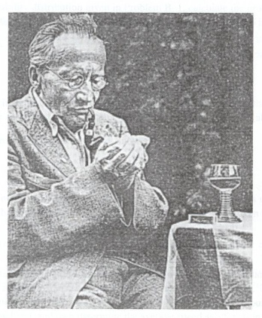
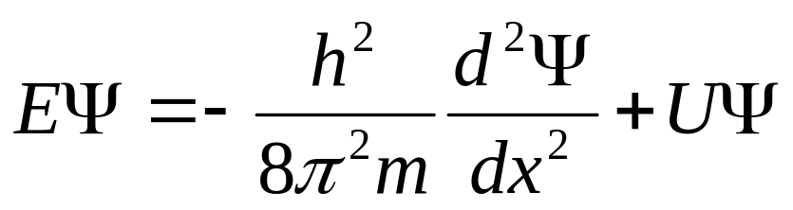
Schrödinger equation (SE)
(Schrödinger Equation in 1-dimension) Time independent SE
“In this communication I wish to show that the usual rules of quantization can be replaced by another postulate (SE) in which there occurs no mention of whole numbers. Instead, the introduction of integers arises in the same natural way as, for example, in a vibrating string, for which the number of nodes is integral. The new conception can be generalized, and I believe that it penetrates deeply into the true nature of the quantum rules.”
Schrodinger in 1926
[from Annalen der Physik 79, 361 (1926)]

Slide 7
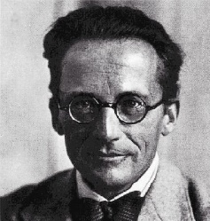
How do we find Ψ(x,t) ?
In classical mechanics
  E(total) = E(kinetic) + E(potential)
  E = p²/2m + V
The rule to find Ψ(x,t) is expressed in the form of a differential equation by Austrian physicist Erwin Schrodinger.
h = Planck’s constant,
U = potential energy,
E = total energy of the particle,
m = mass of particle
(Schrödinger Equation in 1-dimension) Time independent SE
SE plays the same central role in Quantum Mechanics as do Newton’s law in mechanics and Maxwell’s equations in electromagnetism.

Slide 8
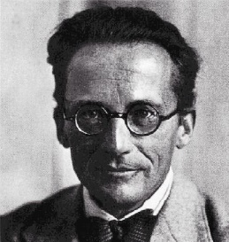
Schrodinger Equation (SE)
Our understanding of QM system such as atoms, molecules, atomic nuclei and electrons in solids is based on solution to this equation for that system.
We can’t “derive” the SE from other principle, it is a new principle of its own.
How do we know that this equation is correct? Because it works! Predictions made using this equation agree with experimental results!
The Schrödinger Equation (SE) provides a way (easier for most students) to describe the quantum world – the other is the matrix formulation by Heisenberg – and we will deal with its simplest form of SE for the next few lectures to get a feel of what QM is.

Slide 9





Quick revision on complex numbers
A complex number z is one which has a real part a and an imaginary part b so that we write:
where
z has a complex conjugate z* given by replacing i with –i, that is:
The product of zz* is real and positive and is equal to the square of the magnitude of z.
Another important equation that you will or had used often is:
(That is all we need about complex numbers/functions for now.)

Slide 10
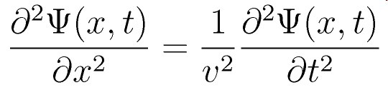


“Getting” the Schrödinger Equation
The (classical) general form of the wave equation for waves traveling along the x axis is
where v = velocity is the wave speed, and Ψ(x, t) is the wave function which depends on x and t.
To make things simple, let us consider the solution of the above where the wave function Ψ(x, t) can be written as the product of two terms that depend on x and t separately, i.e.,
where

Slide 11
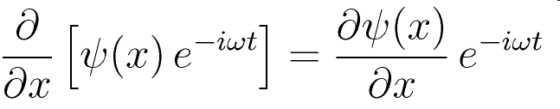
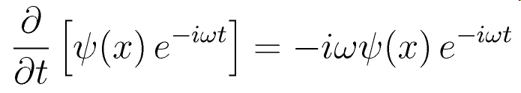
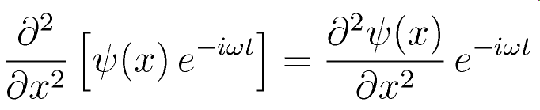
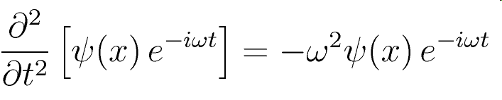
“Getting” the Schrödinger Equation
Doing the partial differentiation on
Substitute back
Substitute back

Slide 12
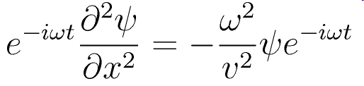
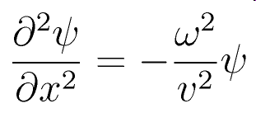
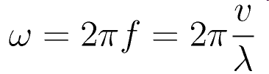
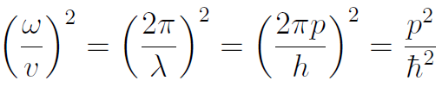
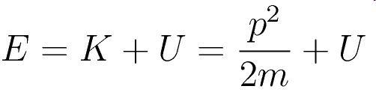

“Getting” the Schrödinger Equation
Substituting in the wave equation, we have
Up to this point, there is still no quantum elements. We know:
For non-relativistic case, the total energy E is

Slide 13
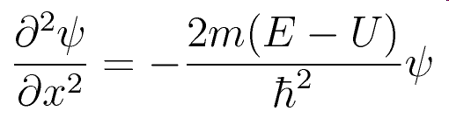
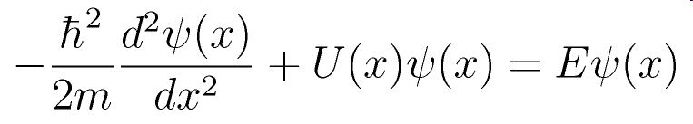
“Getting” the Schrödinger Equation
Substituting the expressions back into the wave equation,
Since ψ(x) is only a function of x, we can write the partial differential as a total differential, and after rearranging we get:
The above is the famous one-dimensional time independent Schrödinger Equation.

Slide 14
1-D Time-Indep. Schrödinger Equation
This is the simplest form of the Schrödinger equation – time independent and confined to one dimension.
The explicit dependence on x is indicated above for the relevant terms. Note that E is independent of x – it is the total energy of the system – sum of KE and PE but not rest energy. There are usually more than one allowed value of E and these are usually what we want to find!
U(x) is the potential energy function which will be different for different systems. It is a function of x. Our next few lectures will be spent on solving the above equation for U(x) as indicated on the next page.

Slide 15

How do we find Ψ(x,t) ?
Ψ(x,t) must depend on the dynamical state of the particle.
This dynamical state is determined by the forces acting on the particle and by the total energy of the particle.
The forces acting on a particle depends on the potential energy of the particle.

Slide 16
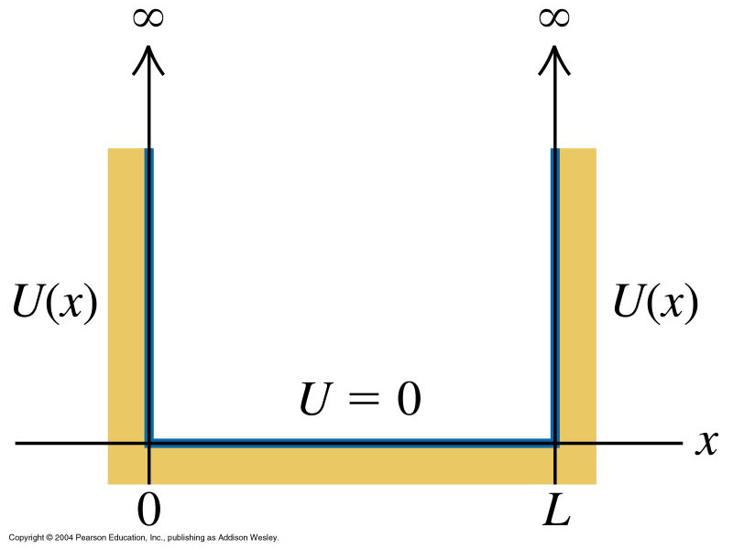
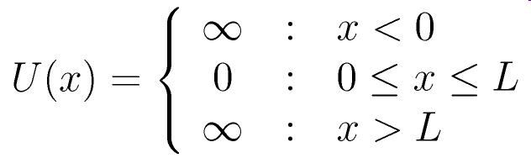
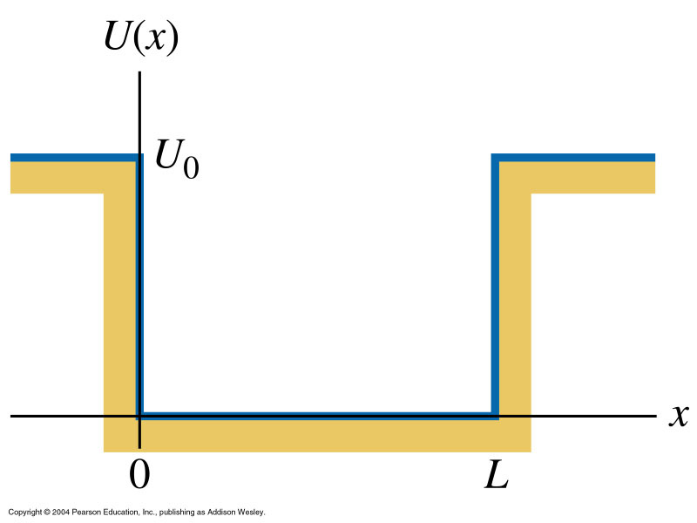
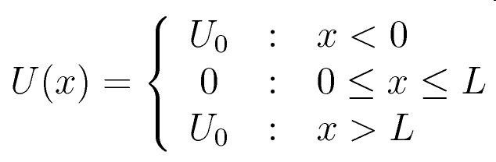
Examples of U(x)
Infinite potential well:
Finite potential well:

Slide 17
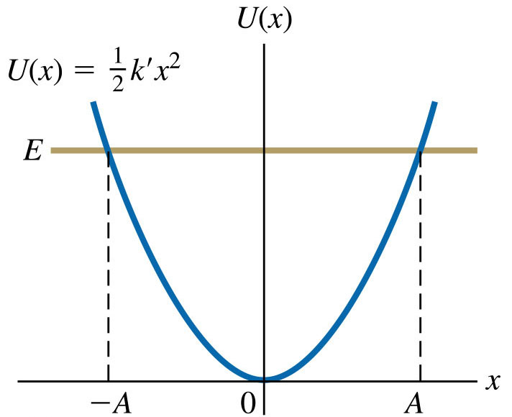
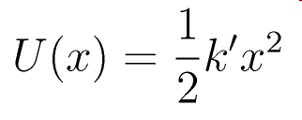
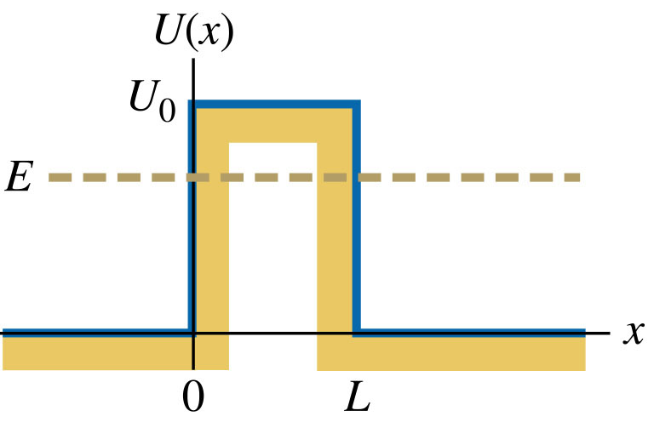
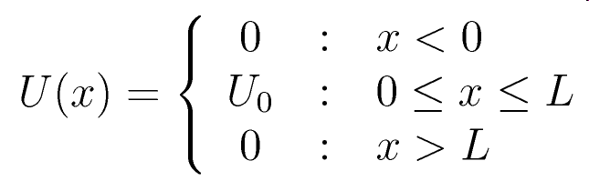
Examples of U(x)
Harmonic potential well:
Potential Barrier:

Slide 18
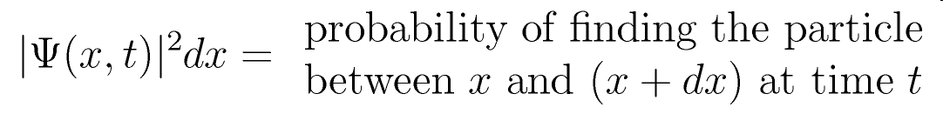
Meaning of Wavefunction
Recall that we have stated earlier that Ψ(x, t) is a complex (with real and imaginary parts) function that satisfy the Schrödinger Equation. It does not represent any physical quantity.
Instead it is |Ψ(x, t)|², that has a physical meaning. Later in the year 1926, Max Born gave |Ψ(x, t)|², known as the probability density, its statistical interpretation that:
For the stationary states, it is easy to see that:
i.e., probability density is independent of time!

Slide 19
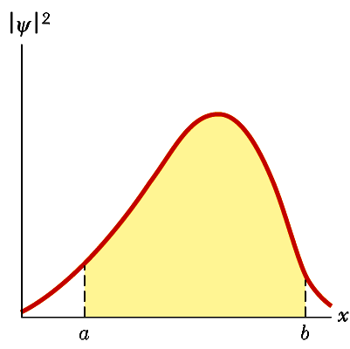
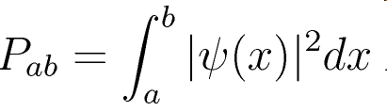
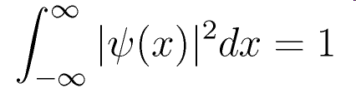
Normalization of Wavefunction
Thus once we find ψ(x) from SE, we can find the probability of the particle to be within certain region say between a and b which is given by:
which is the area under the graph on the right (shaded).
The particle must be found somewhere on the x-axis. Therefore if we integrate |ψ(x)| from -∞ to +∞, we must get 1. This important property is known as normalization, and is used to find one of the constants of the state we need to completely specify the state, i.e.,

Slide 20
Required Properties of ψ(x)
The wave function ψ(x) has to be “well-behaved” mathematically so that measurable quantities, such as momentum, which can be evaluated from it will also be well-behaved.
Therefore to be an acceptable solution to the SE, ψ(x) and its first derivative dψ(x)/dx must have the following properties:
  ψ(x) and dψ(x)/dx must be finite.
  ψ(x) and dψ(x)/dx must be single-valued.
  ψ(x) and dψ(x)/dx must be continuous.
The condition 3 for dψ(x)/dx is relaxed only for the special case where the potential energy has an infinite change in value at some specific values of x.

Slide 21
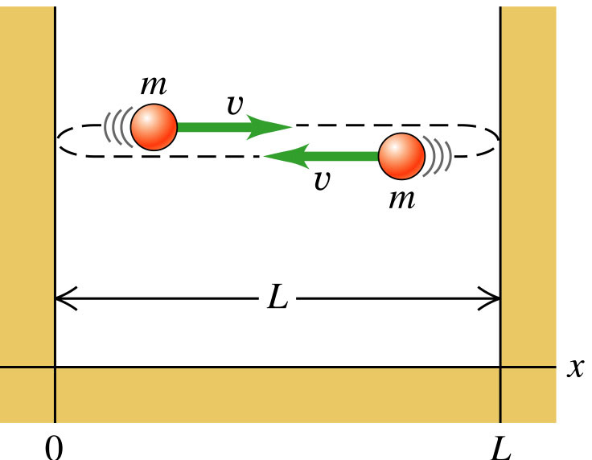
Infinite Potential Well
This is the case of a particle in an impenetrable box (1-D). That is, the particle is confined within the space 0 < x < L for it encounters an infinite force at x = 0 and x = L that will prevent it from going beyond the boundary. Within the boundary the particle encounters no force (dU/dx = 0).
Classically, we know how such a particle behaves. If it has some energy E = K = ½ mv², it will move with constant speed v between the walls. When it makes a collision with the wall, its velocity will instantaneously change so that it moves backwards with same speed as before.
Classical Picture
The motion goes on forever, and it is equally likely to be found in any location within the boundary 0 < x < L.

Slide 22
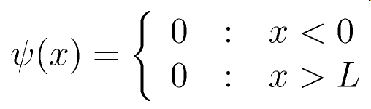
Solution to Infinite Potential Well
Quantum mechanically, for low energy E, the behaviour is quite different.
The potential energy is given by:
Since it is infinite potential for x < 0 and for x > L, in these two regions, we do not expect the particle to be found (true classically and quantum mechanically). So:

Slide 23
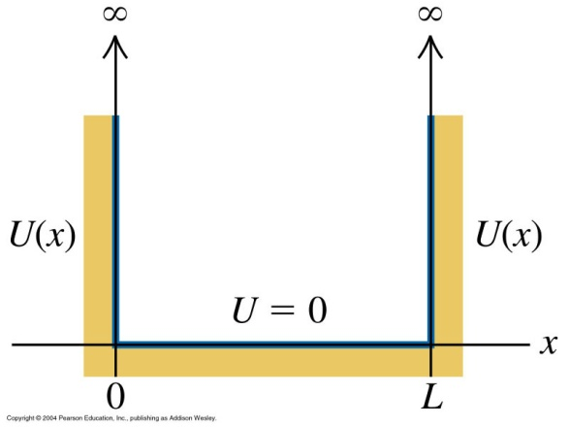
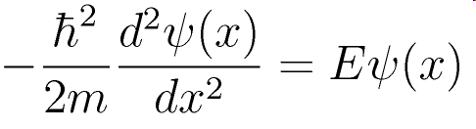
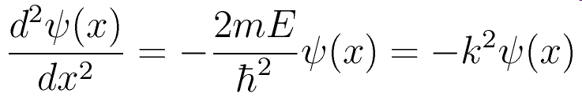
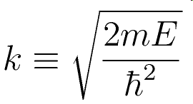
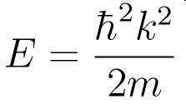
Solution to Infinite Potential Well
Substitute U(x) = 0 in the region 0 < x < L, the Schrödinger Equation becomes
This can be written as:
where
or
(You should be able to spot that k = 2π/λ where λ is the wavelength and momentum p = ħk !)

Slide 24
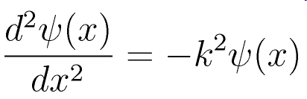

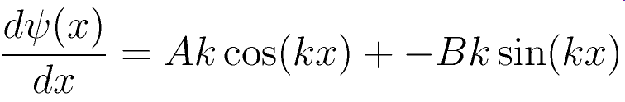
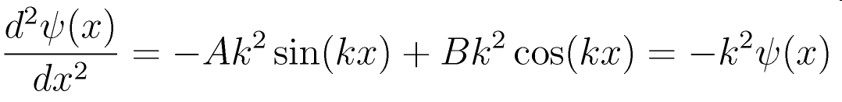
Solution to Infinite Potential Well
You may have solved this second order equation before.
There are a few forms of solution to the above, but we will pick the simplest solution:
You can verify that this is a solution to the above:

Slide 25



Boundary Conditions
The solution:
must satisfy the boundary conditions at x = 0 and x = L such that ψ(x) is single valued and continuous! (We need not use the other conditions on dψ(x)/dx – we have sufficient equations for the unknowns – in fact one of the conditions for dψ(x)/dx does not apply here for infinite potential step.)
Since from earlier consideration we have found that
0
L

Slide 26





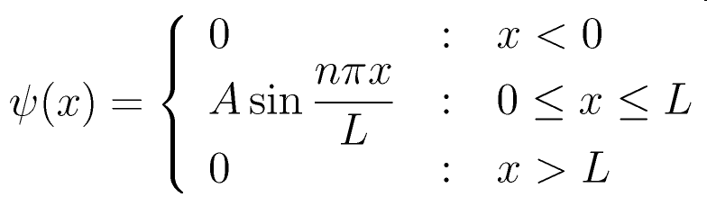

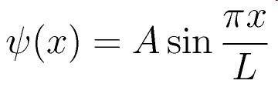
Boundary Conditions
The solution:
See next slide
0
L

Slide 27
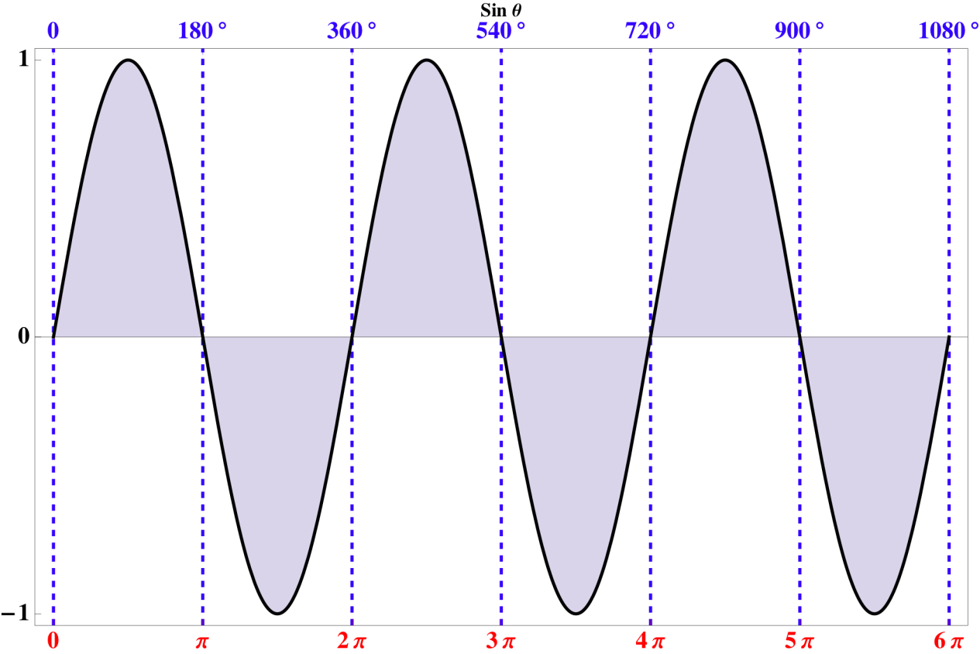
Property of Sine Function
The plot indicates that:
(
is a non zero, +’ve integer)

Slide 28
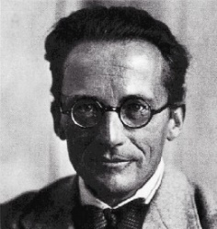
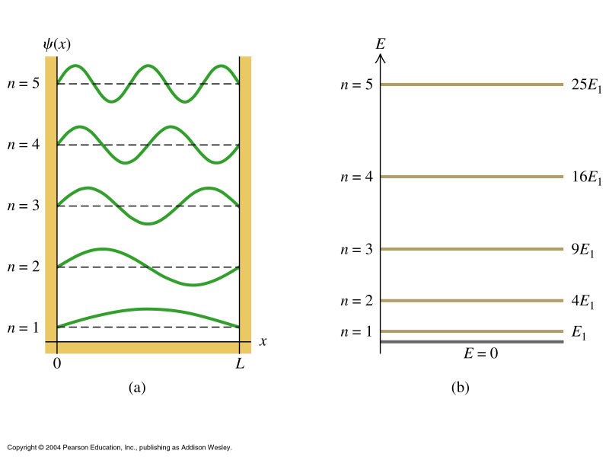
Wavefunction for different n
The equation below will provide us with the complete picture of what we can know about the behavior of particle in a infinite potential well – we will determine A later through normalization.
For larger n, it has a shorter wavelength ⇒ higher momentum and energy.
The different wave functions look exactly the same as the standing waves on a stretched string – we had taken out the time component – which means we are only looking at the amplitude of the standing waves.

Slide 29
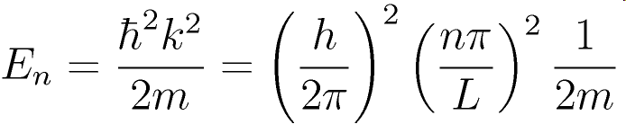
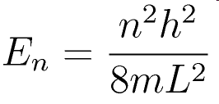
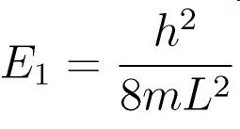

Energy Levels
Note that energy quantization come in very naturally.
and
The lowest energy, that of the ground state with n = 1, is non-zero, as expected from Heisenberg Uncertainty Principle. This is known as the zero-point energy.

Slide 30
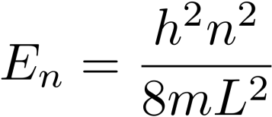
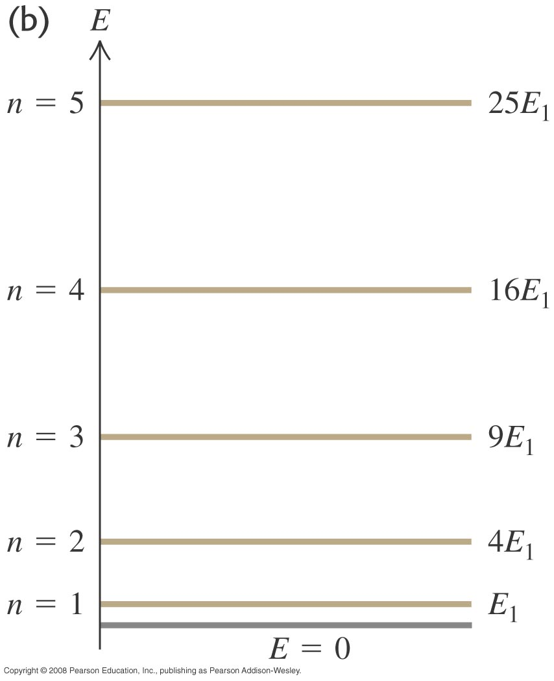
Quantization of Energy Levels
Particle cannot have any arbitrary energy!!!
Only values given by above equation are allowed.
The energy of the particle is quantized !!! A result not expected by many people!!
The number n is known as the Principal Quantum Number.

Slide 31



Probability Density
The probability of finding the particle within a range dx about position x is |ψ(x)|²dx where

Slide 32

Probability Density
The probability is different from the classical case – which was a constant anywhere within the boundary. Here it varies as a function of sin²(nπx/L).
For n = even, the probability of finding the particle is zero at the centre of the well, but is maximum for n = odd.
It approaches zero at both boundaries for all values of n.

Slide 33







Normalization
To find the actual probability we need to know the value of A, which can be calculated by the normalization process. Since the probability of finding it outside the boundary is zero,

Slide 34



Example: Probability
For n = 1, what is the probability of finding the particle in the region
  0 ≤ x < 0.1L ;
  0 ≤ x < 0.3L ;
  0.45L ≤ x < 0.55L ?
Do the same for n = 2.
n = 2
n = 1

Slide 35

Example: Size of Box
If the particle is an electron, for what value of L will the ground state (n = 1) energy be:
  1.0 eV
  10 eV
For the same value of L as in (a) above, what would the ground state energy be for a proton? If L is the size of the nucleus (5 × 10⁻¹⁵ m), what is the ground state energy?

Slide 36
Quantization of Energy Levels
This situation of only certain energy values being allowed is not a peculiarity of particle in a box.
It generally holds whenever we encounter physical systems where a particle is in a potential that confines the particle to move in a limited region.
Examples of such systems include an electron orbiting an atomic nucleus or a particle in a potential well of any shape

Slide 37
Question
Which of the following statements does not apply to both electron in a potential box and electron in a hydrogen atom?
  Both systems can be adequately described using the Schrodinger Equation.
  The energy of the system is quantized.
  Both are example of systems with confining potential.
  The energy difference between one energy level and the next higher energy level increases with increasing quantum number n.
  The properties of the electron are described by a probability wave function.

Slide 38
“Particle in a box” systems in Physics and Engineering

Slide 39
Quantum Well
Is particle-in-a-potential-box a realistic physical system that one encounters in natural world?
Yes !!! Because we have already made such a system in semiconductor technology.
Quantum Well, Quantum Wire and Quantum dots.
For a long period of time, particle-in-a-potential-box remained a standard problem in QM textbook without any physical realization.
However, with the advance of technology, such a system can be realized experimentally and in fact it has become incorporated into a wide variety of devices.

Slide 40




Quantum Well
If you create a system made of a stack of layers of GaAs and AlAs as shown
Electrons prefer to be in the GaAs layers. (Energetically favorable for the electron to do so).
An electron is thus confined in a potential well created by a layer of GaAs sandwiched between two layers of AlAs.
Electrons are confined in a narrow region bounded by two walls. This is just like the problem of particle in a potential box (well) in quantum mechanics.
The energy depth of the well can be varied over a range of about 500 meV, for example by employing an alloy Al_{x}Ga_{1-x}As rather than just pure AlAs for the barrier layers.
This difference becomes of practical use in GaAs/AlAs system when the width of the GaAs layer is reduced to less than a few hundred angstrom.

Slide 41
Two Dimensional Electron Gas
Quantum Well
Electrons free to move around in this plane. That is, they are free to move around in this 2D world.
Note that the potential well produced in the above quantum well confines the electron only in one direction (vertical direction).
The electron is essentially free in the plane. Hence the name two-dimensional electron gas or 2DEG is used to refer to these electrons.
High-speed electronics devices such as high electron mobility transistor (HEMT) and optical devices such as lasers, are some of the practical applications of these heterostructures.

Slide 42
Molecular Beam Epitaxy
How to make these Quantum Wells?
With well control epitaxial technique like molecular beam epitaxy (MBE), it is possible to grow layered ultrahigh purity thin single-crystalline films of compound semiconductors, where the thickness of each layer can be precisely controlled down to a single layer of atoms (approximately a few angstrom thick).

Slide 43

Molecular Beam Epitaxy

Slide 44

How to make these Quantum Wells?
Molecular Beam Epitaxy- Spray Painting with Atoms
It is like spray painting with atoms. From little ovens charged with basic ingredients, atoms or molecules effuse into a chamber where they then deposit onto a heated surface placed inside. Computer-controlled shutters control which ingredient enter the chamber at any particular time.

Slide 45
How do we monitor the layer growth?
Reflection high-energy electron diffraction (RHEED)
Important MBE tool used to monitor the evolution of the terrace widths while growth is taking place.
It consists of analyzing high-energy electrons (~10 keV) that have been reflected from the surface plane.
In this geometry, the electrons are sensitive to the arrangement of essentially the top layer or two of atoms.
When the beam is directed down the surface steps, the periodic steps result in a series of diffracted electron beams, and from their spacing and shape we can deduce the step periodicity and terrace width uniformity, respectively.

Slide 46



How do we monitor the layer growth?
RHEED Pattern
Illustration of the mechanism ofor RHEED specular spot intensity oscillations during the growth of a monolayer.
M. Ohring, The Material Science of Thin Films, Academic Press, 1992

